Slide 1











RNN Variation – LSTM
$$\hat{y_{t}}$$
Long short-term memory
Includes a “forget gate”
Cell structure has both memory of features and current data
Cells can choose what features to forget
Addresses the problem of losing long-term dependencies
More applicable in analyzing heart murmur data
Heart sound data can have two major modes: S1 and S2 (fundamental sounds) followed by murmurs
Still can face vanishing or exploding gradient issues
$$c_{t−1}$$
×
+
$$c_{t}$$
×
Forget
$$σ$$
$$σ$$
$$Softmax$$
$$Softmax$$
Input and candidate memory
Output
$$h_{t−1}$$
$$σ$$
×
$$h_{t}$$
$$x_{t}$$

Slide 2

















Novel Multi-Modal LSTM
$$\hat{y_{t}}$$
Each mode of an input signal receives a separate memory channel
Linear combination of modes gives output
M1_add
$${m_{1}}_{t−1}$$
×
f1
+
$${m_{1}}_{t}$$
$${m_{2}}_{t−1}$$
×
×
$${m_{2}}_{t}$$
×
f2
+
×
×
$$w_{1}$$
$$w_{2}$$
Forget
+
$$σ$$
$$σ$$
$$σ$$
$$Softmax$$
$$σ$$
$$Softmax$$
Input and candidate memory
$$Softmax$$
$$h_{t−1}$$
$$σ$$
+
$$h_{t}$$
+
$$x_{t}$$

Slide 3
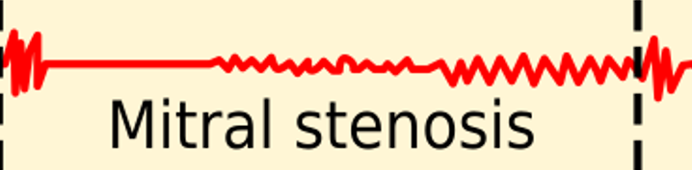
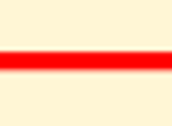



















Novel Multi-Modal LSTM
“Mode” is just a repeating component of the input heart signal
Mode 1 ($m_{1}$) includes the main heart beats
Mode 2 ($m_{2}$) includes all extraneous noises/murmurs
$$\hat{y_{t}}$$
$$+$$
$${m_{1}}_{t−1}$$
×
+
$${m_{1}}_{t}$$
$${m_{2}}_{t−1}$$
×
$${m_{2}}_{t}$$
$$=$$
×
+
$$w_{1}$$
×
×
×
$$w_{2}$$
Forget
+
$$σ$$
$$σ$$
$$σ$$
$$Softmax$$
$$σ$$
$$Softmax$$
$$Softmax$$
Putting the two independent modes gives us the complete heart sound signal
Input and candidate memory
$$h_{t−1}$$
$$σ$$
+
$$h_{t}$$
×
$$x_{t}$$

Slide 4
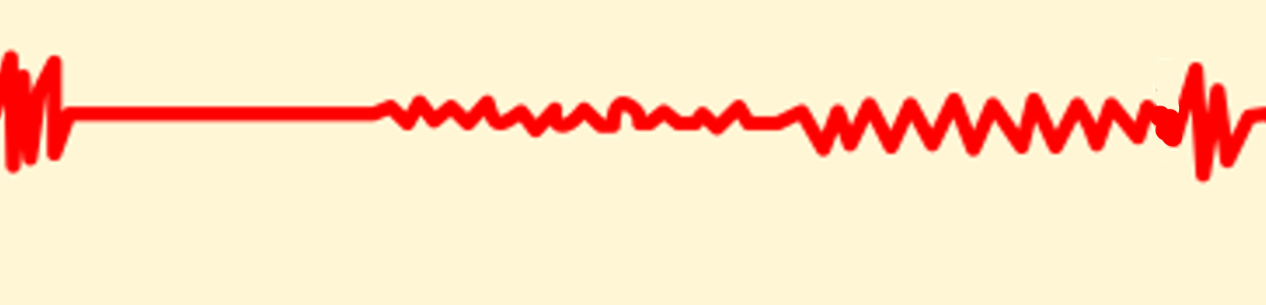
Comparison of Standard vs. Novelty
Standard LSTM
Novel Multi-Modal LSTM
Evaluates entire signal as a single stream of data
Potential of creating unwanted interdependencies between main heart sounds and murmurs
Input signal is split into a mode for main heart beats and a second mode for murmurs
Custom forget gates to split main heart sounds and murmurs prevent unwanted interdependencies

